Slide 1
Generating noisy speech data from clean data in the frequency domain using Deep Learning Methods
Week – 2
Name: Shashank Shirol
University: Manipal Institute of Technology
Duration of the presentation: ~10 mins.

Slide 2
Tasks to be completed:
Clean the feature extracting code to streamline spec generation and reconstruction
Modify SinGAN base code such that it does not scale down images while training.
Modify the paint2image module of SinGAN to preserve shape of paint image when generating outputs.
Input audios didn’t have high frequencies, reduce the sampling rate so that spec only captures relevant data.
Run SinGAN with different variations of training and paint image combinations and document the results.

Slide 3
Cleaning the ‘feature extract’ code:
Used the argparse library to streamline using the feature extraction code. Code now supports runtime parameters that generate spec audio or reconstruct audio from spec.
python pretty_extract.py -i <input_file> -c <1|0> -r <1|0> -b <int> (optional, default 1) -n <int> (optional, default 1)
-c is to denote if the input audio is the clean variant or not; decides whether phase info is stored or not.
-r is to denote if running in reconstruction mode (from spec to audio) or not.
-n is to denote the number of channels in the image.
-b is number of byte representation for the spectrogram image; default is 1.
As opposed to previous set-up where we had 2 different files, one for spec generation and one for reconstruction.

Slide 4
Modifying the SinGAN base code (I):
SinGAN, while training and generating random samples from an input image, re-scales the images to a predetermined maximum dimension (if the input image was large).
We can not have this when dealing with spectrograms i.e. the size of the spectrogram must be preserved.
So, the SinGAN code had to be altered to maintain the dimensions.
Before:
After:
W x H
SinGAN
W’ x H’
W x H
SinGAN
W x H

Slide 5
Modifying the SinGAN base code (II):
The Paint to Image module of SinGAN reshaped the output to match the dimensions of the training image and not the paint image.
Training image is the noisy spec and we are interested in introducing noise in the clean spec (paint image)
So, the Paint2Image code had to be altered to use the paint image dimensions.
Before:
After:
Train img
Train img
P2i module
output
P2i module
output
Paint img
Paint img
(With train img dimensions)
(With paint img dimensions)

Slide 6
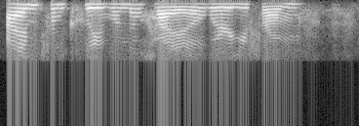
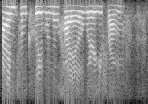
Altering the sampling rate of input audios:
Input samples don’t have a higher frequencies, so the spectrogram image produced is unnecessarily large and has irrelevant sections.
Solution is to resample the audios so that the spec captures only relevant data.
Before:
After:
Frequencies not present

Slide 7
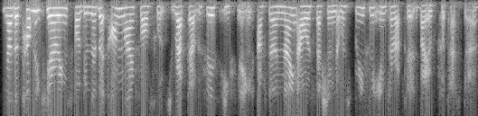
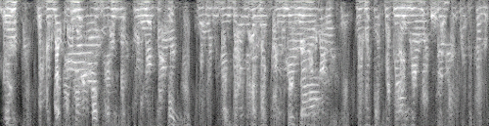

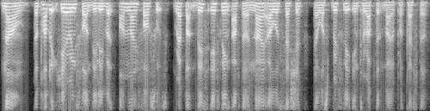
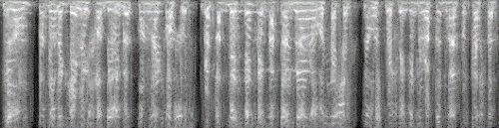
Running SinGAN with different training and paint image combinations (I):
Training Image: Noisy Female Spec Paint Image: Clean Male Spec Content: Same
Observation: Generates observable outputs early (from scale 2).
Training Audio:
Scale 1
Paint Audio:
Scale 2

Slide 8
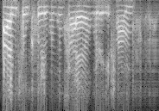
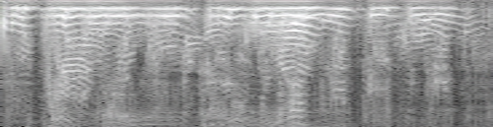
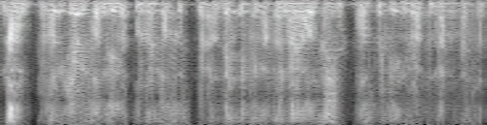
Running SinGAN with different training and paint image combinations (II):
Training Image: Noisy Female Spec Paint Image: Clean Male Spec Content: Different
Observation: Generates observable outputs at higher scales (from scale 5-6).
Training Audio:
Scale 1
Paint Audio:
Scale 5

Slide 9
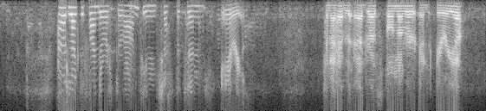
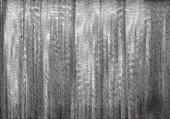
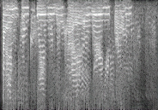
Running SinGAN with different training and paint image combinations (III):
Training Image: Noisy Female + Male Spec Paint Image: Clean Female Spec Content: Different
Observation: Generates observable outputs early (from scale 2).
Training Audio:
Scale 1
Paint Audio:
Scale 2

Slide 10
End.

